Slide 1
Accessibility Framework for Determining Collisions and Coverage for Radiation Scanning.
Joshua Bettles¹, Andrew West¹, Jeremy Andrew², Iain Darby^{3,4}, and Barry Lennox¹
¹Manchester Centre for Robotics and AI, The University of Manchester, Manchester M13 9Pl, UK
²Nuclear Restoration Services Ltd. Dounreay, Thurso, Caithness, KW14 7TZ, UK
³National Nuclear Laboratory, Chadwick House, Birchwood Park, Warrington, Cheshire, WA3 6AE, UK
⁴School of Physics and Astronomy, University of Glasgow, Glasgow, G12 8QQ, UK

Slide 2
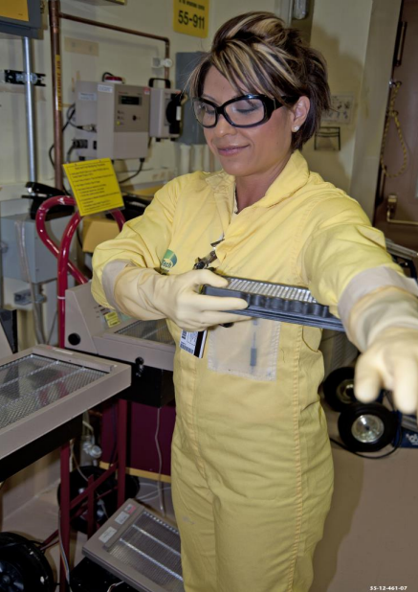
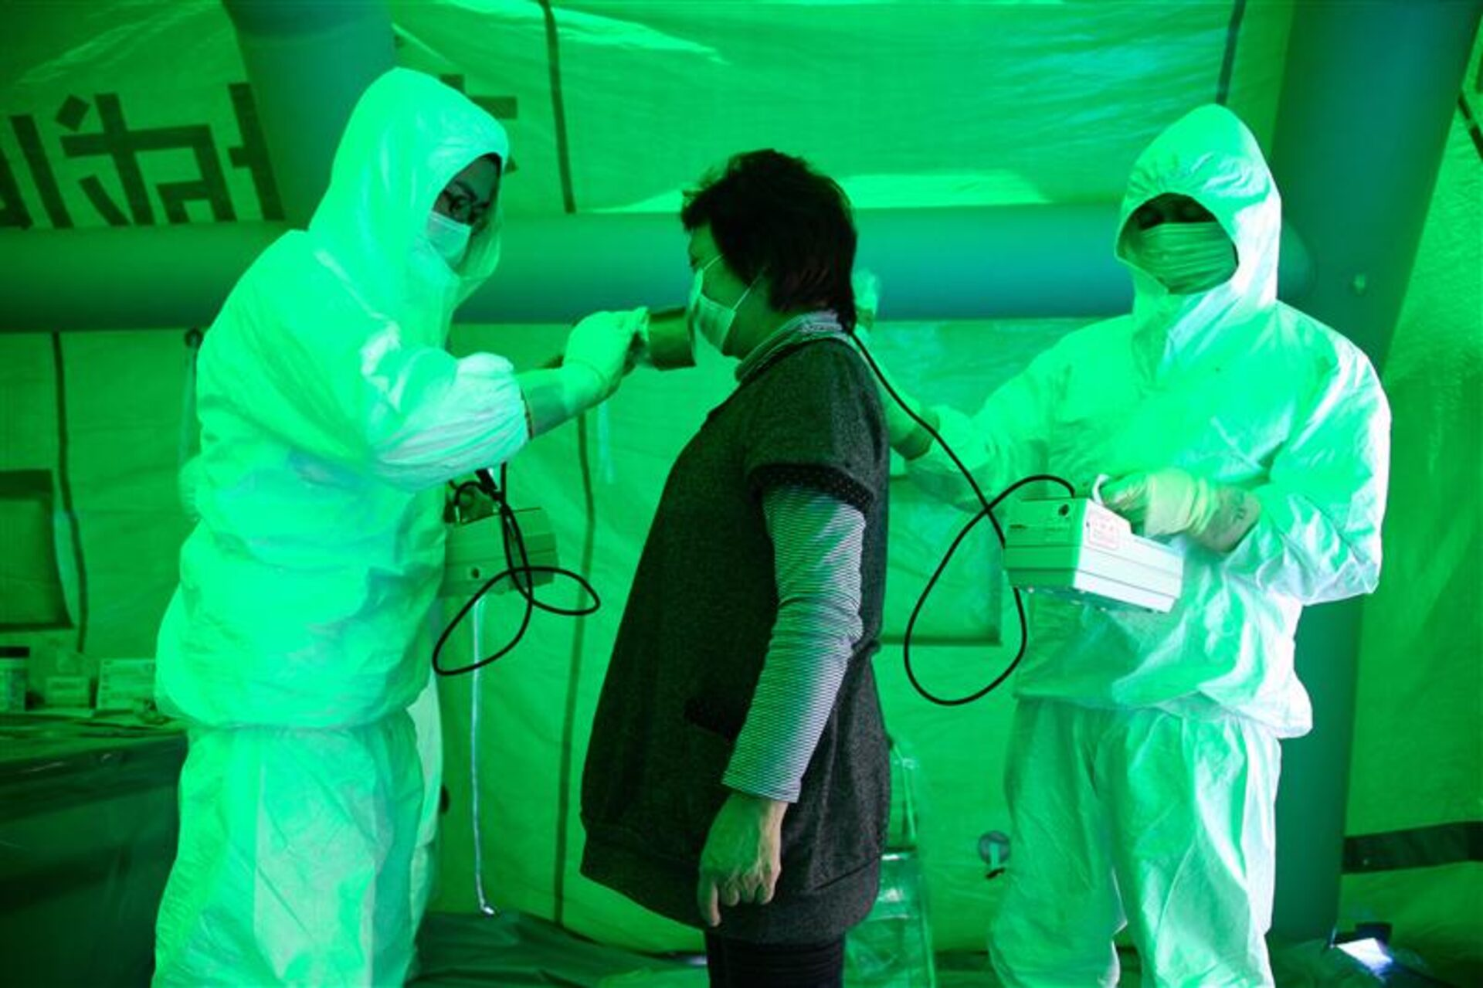
Manual Frisking
Automate Frisking
Collaborative Robot
Path Planning
Accessibility Framework
[1]
[2]
Contribution of this work
[1] M. E. Cournoyer, “Contamination control monitoring at the Los Alamos National Laboratory’s Plutonium Facility,” Journal of Chemical Health &amp; Safety, vol. 25, no. 2, pp. 28–32, Mar. 2018. doi:10.1016/j.jchas.2017.10.008
[2] A. Shimbun, Nuclear fears at fukushima, [Accessed 26-05-2024], Mar. 2011. [Online]. Available: https://www.reuters.com/news/picture/nuclear-fears-at-fukushimaidUSRTR2JTMQ/

Slide 3
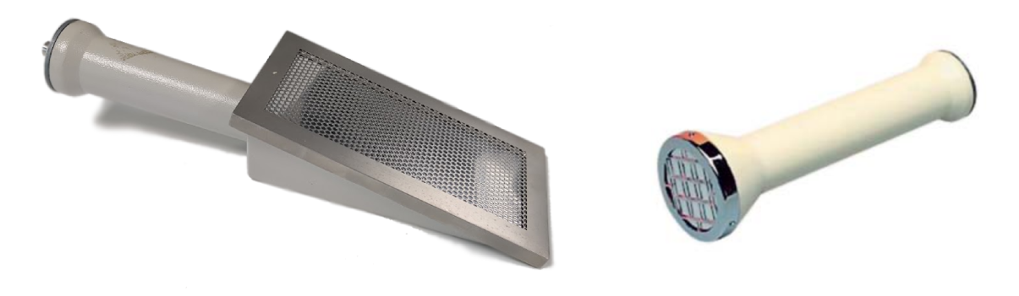
Radiation Probes
Sensor Film
DP6 Probe
BP4 Probe
Thermo FisherScientific: Non-Intelligent and Intelligent Scintillation Probes Instruction Manual (8 2006)
Notes:
https://www.google.com/url?sa=i&url=https%3A%2F%2Fwww.radiationtraining.co.uk%2Femployer-responsibilities%2Fionising-radiation-regulations%2F&psig=AOvVaw3ed4-N3_QmyWozEfiTEz3w&ust=1721751662471000&source=images&cd=vfe&opi=89978449&ved=0CBIQjhxqFwoTCNDSlPSGu4cDFQAAAAAdAAAAABAJ
https://www.oecd-nea.org/jcms/c_12890/radiological-protection
https://www.google.com/url?sa=i&url=https%3A%2F%2Fwww.medicalnewstoday.com%2Farticles%2Ftypes-of-radiation-therapy&psig=AOvVaw35MdyCSY0UevXrna1RPp28&ust=1721751752465000&source=images&cd=vfe&opi=89978449&ved=0CBIQjhxqFwoTCMDRo56Hu4cDFQAAAAAdAAAAABAJ
https://www.google.com/url?sa=i&url=https%3A%2F%2Fwww.argonelectronics.com%2Fblog%2Fsrp-annual-conference-radiation-protection&psig=AOvVaw1TxD23wlupZHATE32pY4QL&ust=1721751815477000&source=images&cd=vfe&opi=89978449&ved=0CBIQjhxqFwoTCNjbt7-Hu4cDFQAAAAAdAAAAABAE
https://www.google.com/url?sa=i&url=https%3A%2F%2Fmarshield.com%2Fchoosing-the-right-radiation-shielding-factors-considered-by-a-shielding-materials-expert%2F&psig=AOvVaw39nMhCFMBuSrJaPJFprzBz&ust=1721751885288000&source=images&cd=vfe&opi=89978449&ved=0CBIQjhxqFwoTCIDs6d6Hu4cDFQAAAAAdAAAAABAE

Slide 4
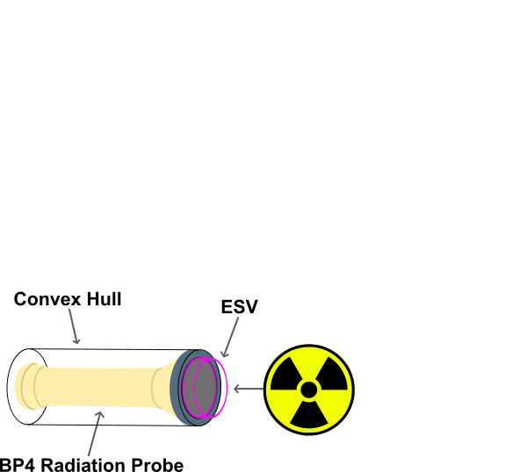
Effective Scan Volume
Sensor Film
BP4 Probe
Thermo FisherScientific: Non-Intelligent and Intelligent Scintillation Probes Instruction Manual (8 2006)
Notes:
https://www.google.com/url?sa=i&url=https%3A%2F%2Fwww.radiationtraining.co.uk%2Femployer-responsibilities%2Fionising-radiation-regulations%2F&psig=AOvVaw3ed4-N3_QmyWozEfiTEz3w&ust=1721751662471000&source=images&cd=vfe&opi=89978449&ved=0CBIQjhxqFwoTCNDSlPSGu4cDFQAAAAAdAAAAABAJ
https://www.oecd-nea.org/jcms/c_12890/radiological-protection
https://www.google.com/url?sa=i&url=https%3A%2F%2Fwww.medicalnewstoday.com%2Farticles%2Ftypes-of-radiation-therapy&psig=AOvVaw35MdyCSY0UevXrna1RPp28&ust=1721751752465000&source=images&cd=vfe&opi=89978449&ved=0CBIQjhxqFwoTCMDRo56Hu4cDFQAAAAAdAAAAABAJ
https://www.google.com/url?sa=i&url=https%3A%2F%2Fwww.argonelectronics.com%2Fblog%2Fsrp-annual-conference-radiation-protection&psig=AOvVaw1TxD23wlupZHATE32pY4QL&ust=1721751815477000&source=images&cd=vfe&opi=89978449&ved=0CBIQjhxqFwoTCNjbt7-Hu4cDFQAAAAAdAAAAABAE
https://www.google.com/url?sa=i&url=https%3A%2F%2Fmarshield.com%2Fchoosing-the-right-radiation-shielding-factors-considered-by-a-shielding-materials-expert%2F&psig=AOvVaw39nMhCFMBuSrJaPJFprzBz&ust=1721751885288000&source=images&cd=vfe&opi=89978449&ved=0CBIQjhxqFwoTCIDs6d6Hu4cDFQAAAAAdAAAAABAE

Slide 5
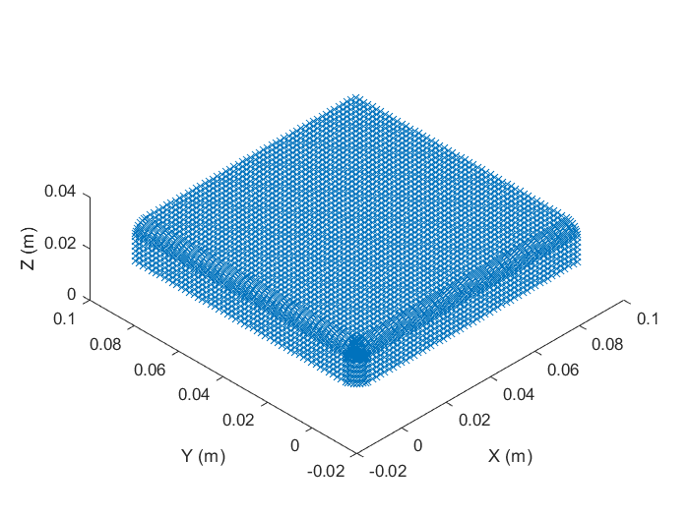
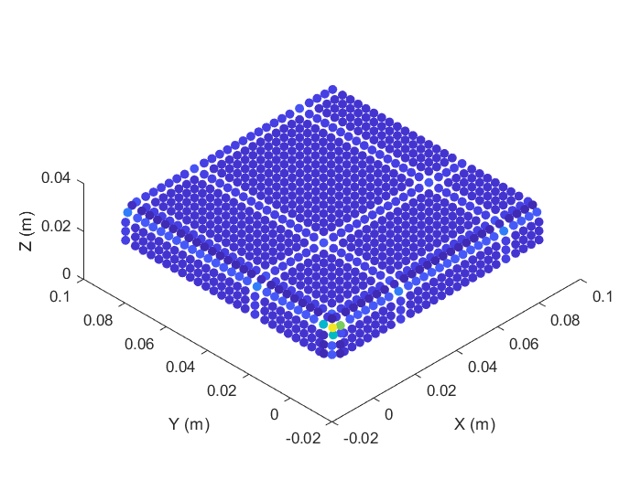
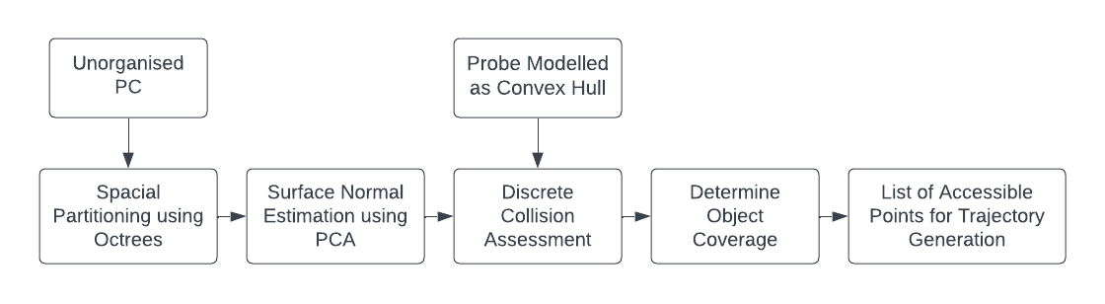
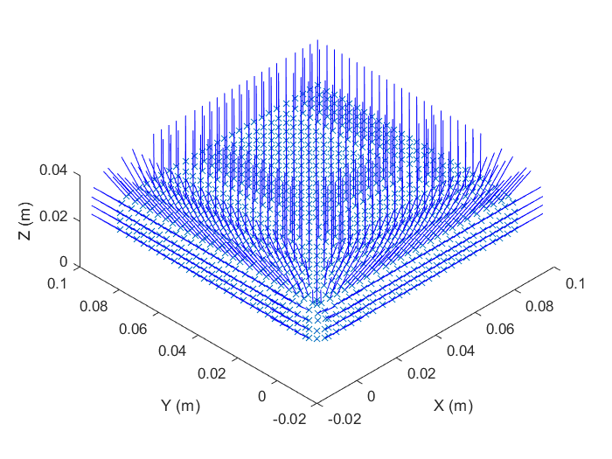
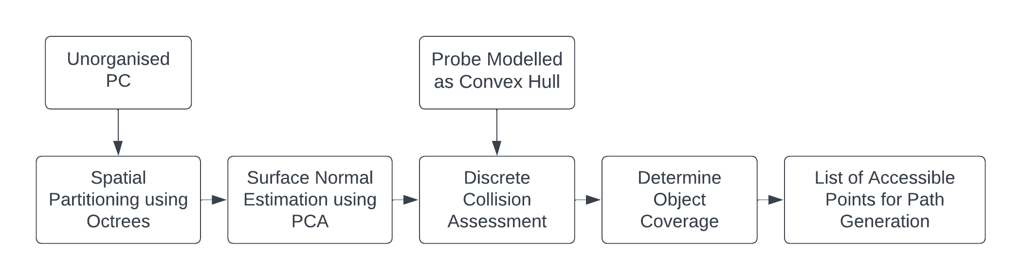
Accessibility Framework

Slide 6
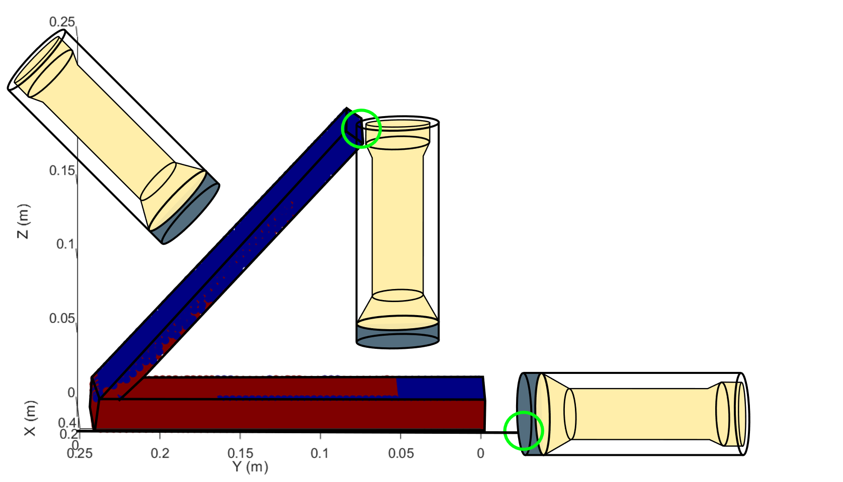
Accessibility Framework

Slide 7
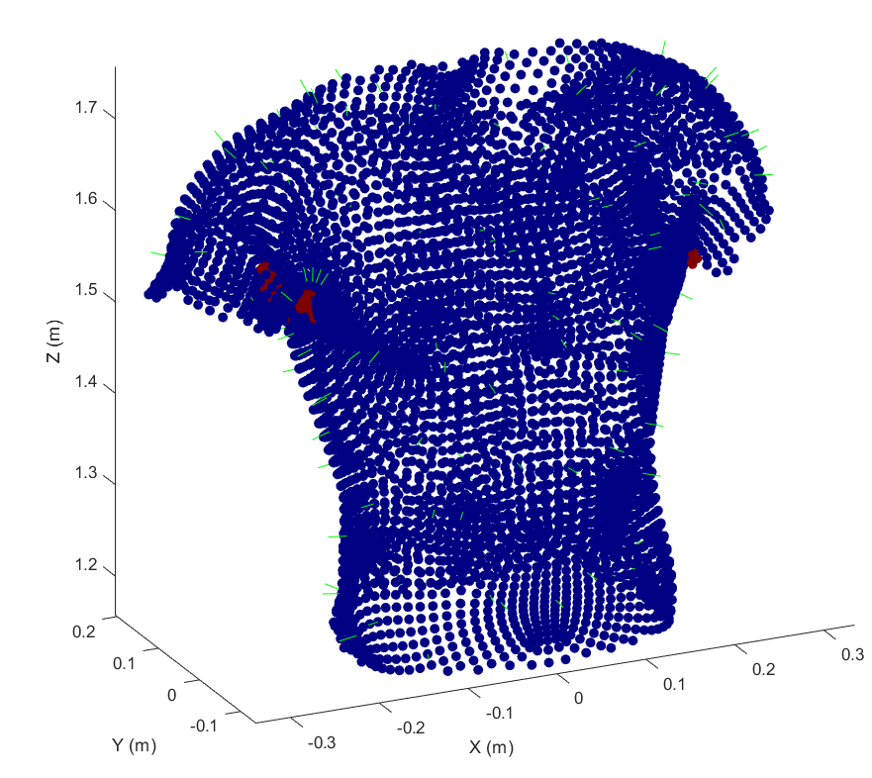
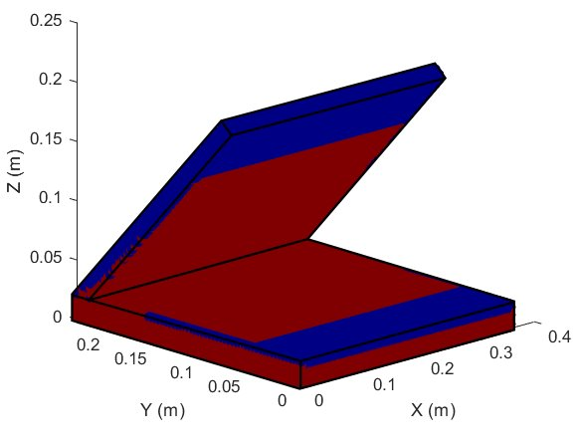
Accessibility Framework
Inaccessible
Accessible

Slide 8
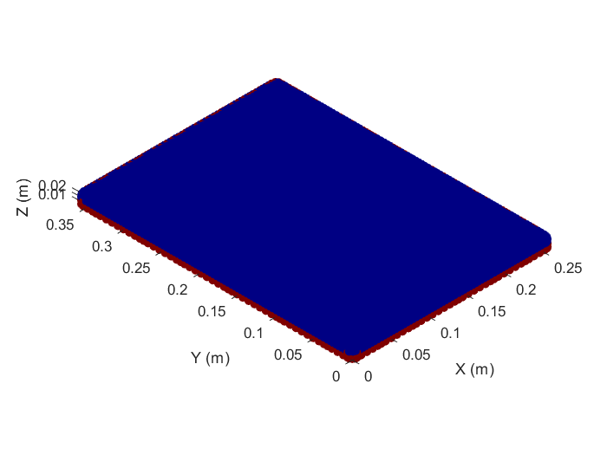
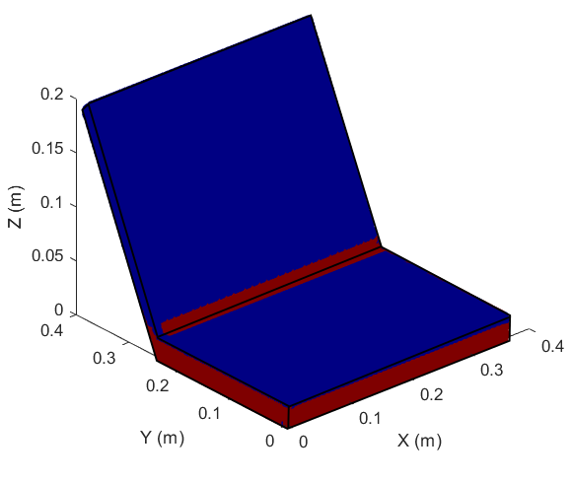
Results
1
Provides an understanding of
object coverage by a probe
2
Identifies regions of potential unknown contamination
3
Generates a set of
accessible points
4
Performs over complex
geometries
Model​ | Leaf Octants​ | Accessible (%)​ | Coverage (%)​ | Assessment Time (S)​
Flat Box​ | 7339​ | 89.33​ | 94.96​ | 0.62​
Laptop (1)​ | 18722​ | 43.11​ | 53.90​ | 3.86​
Laptop (2)​ | 17460​ | 61.23​ | 75.84​ | 3.76​
Torso​ | 5398​ | 70.84​ | 90.08​ | 0.5​
5
Determines collisions with constraints

Slide 9
Conclusion:
Future work:
Effectively distinguishes accessible from inaccessible areas within point clouds
Determining minimum required
scan points
1
1
Provides an insight and
understanding of object coverage
Generate and execute paths over
the objects to be examines
2
2
Provides a basis for planning scan paths over objects for a robot to execute
Generalising the framework for
other applications and probes
3
3

Slide 10
Thank you for Listening
Questions?
Email: joshua.bettles@manchester.ac.uk
LinkedIn: Joshua Bettles
This work is supported by funding from an Industrial Cooperative Awards in Science & Engineering (iCASE) by Nuclear Restoration Services Dounreay, the Nuclear Decommissioning Authority and EPSRC. AW acknowledges support from UK Research and Innovation via project EP/V026941/1.

